Slide 1
Statistical Analysis
By :- Ravikant Tyagi

Slide 2
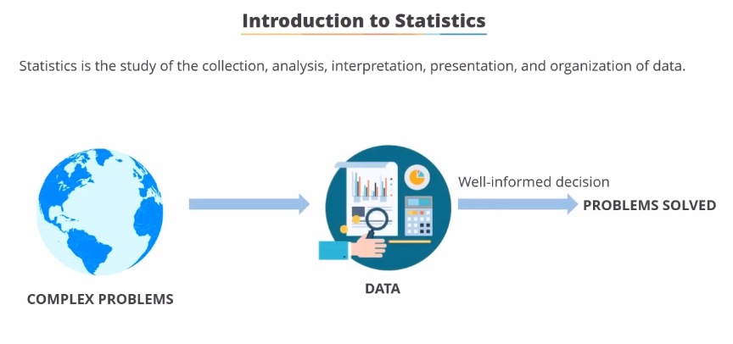

Slide 3
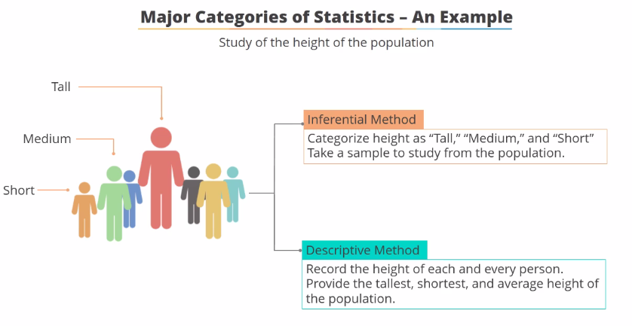

Slide 4
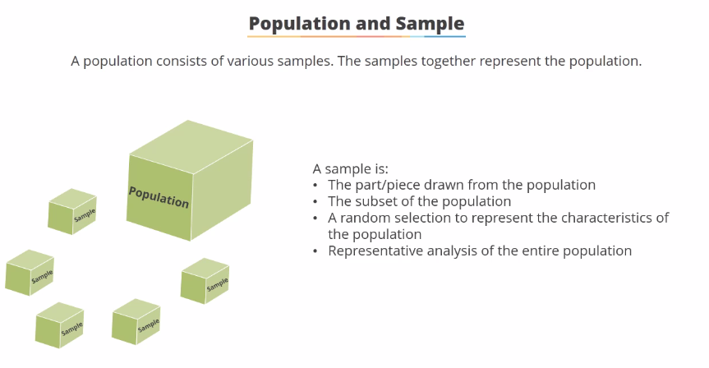

Slide 5
Types of Data
Numerical
Categorical
Ordinal

Slide 6
Numerical
Represents some sort of quantitative measurement
Height of people, page load times, stock prices
Continuous Data
Has an infinite number of values
How much time did it take for a user to check out ?
How much rain fell on a given day ?
Discrete Data
Integer based : Often counts of some event
How many purchases did a customer make in a year ?
How many times did I flip “Heads” ?

Slide 7
Categorical
Qualitative data that has no inherent mathematical meaning.
Gender, Yes/No (binary data), Race, State of Residence, Product Category etc.
You can assign numbers to categories in order to represent them more compactly, but the number does not have mathematical meaning.

Slide 8
Ordinal
A mixture of numerical and categorical.
Categorical data that has mathematical meaning.
Example : Movie ratings on 1-5 Scale.
Ratings must be 1,2,3,4 or 5
But these values have mathematical meaning
1 means it’s a worse movie than 2

Slide 9
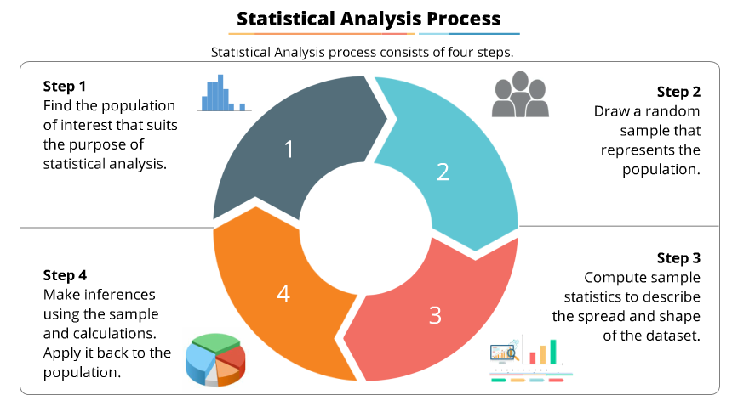

Slide 10
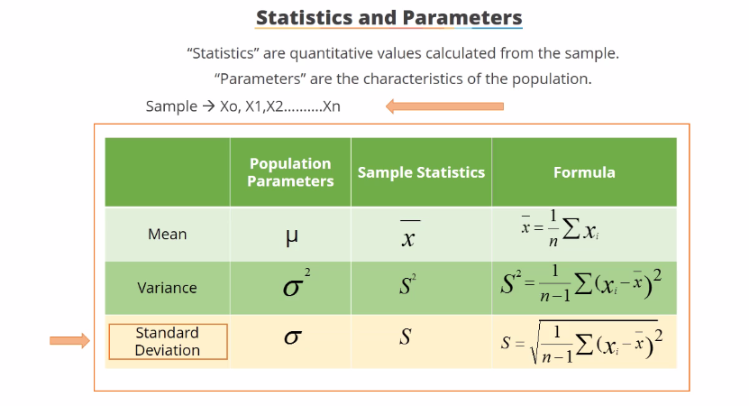

Slide 11
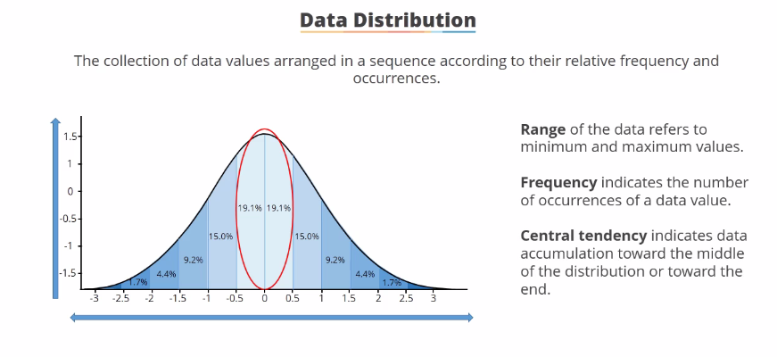

Slide 12
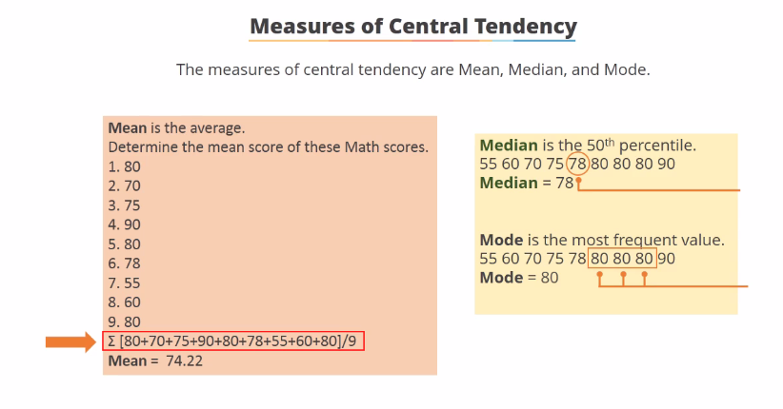

Slide 13
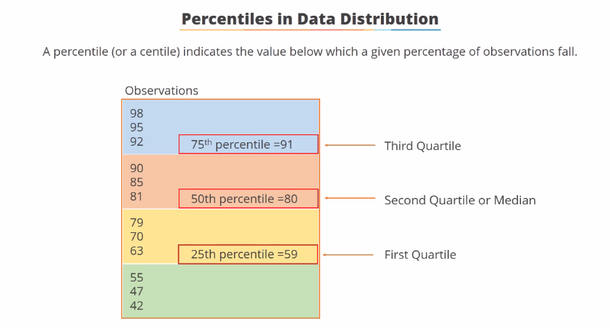

Slide 14
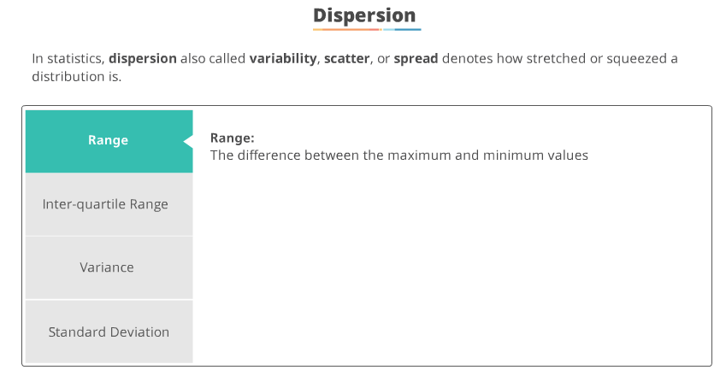

Slide 15
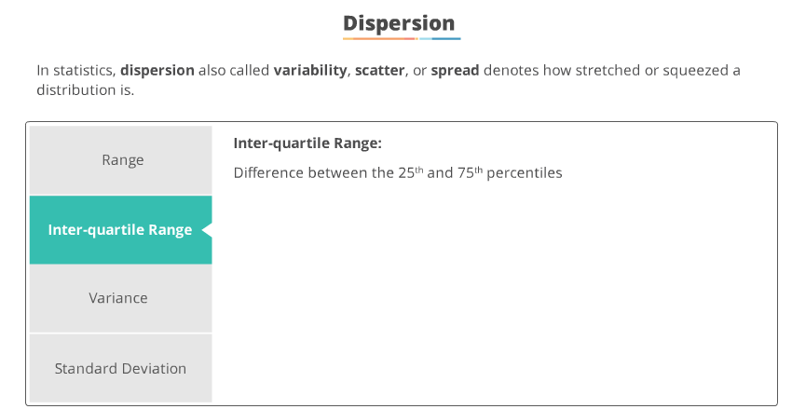

Slide 16
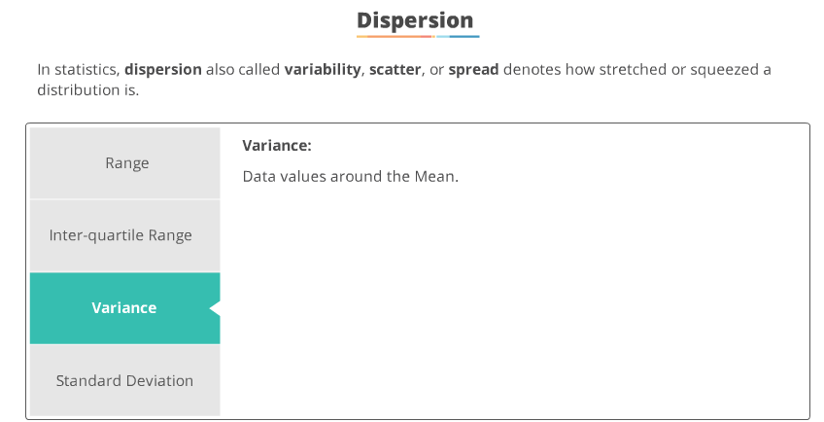

Slide 17
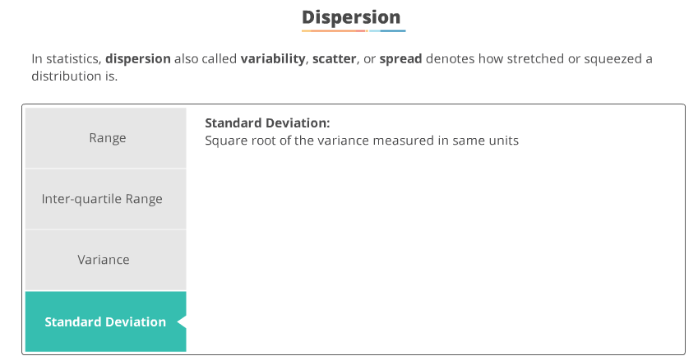

Slide 18
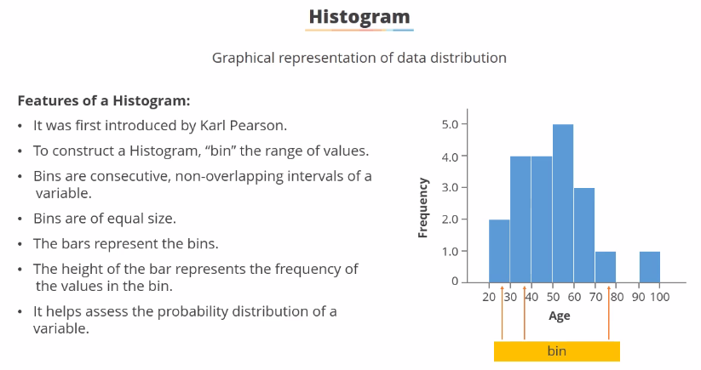

Slide 19
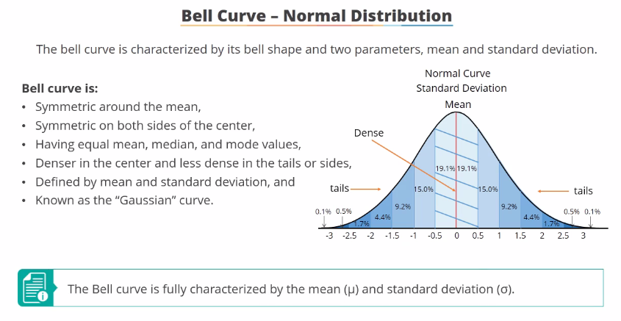

Slide 20
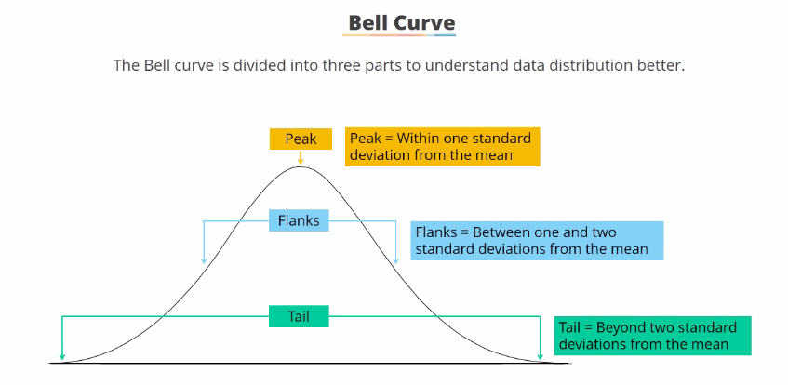

Slide 21
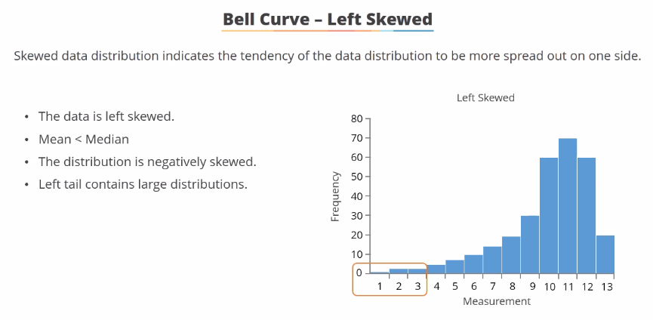

Slide 22
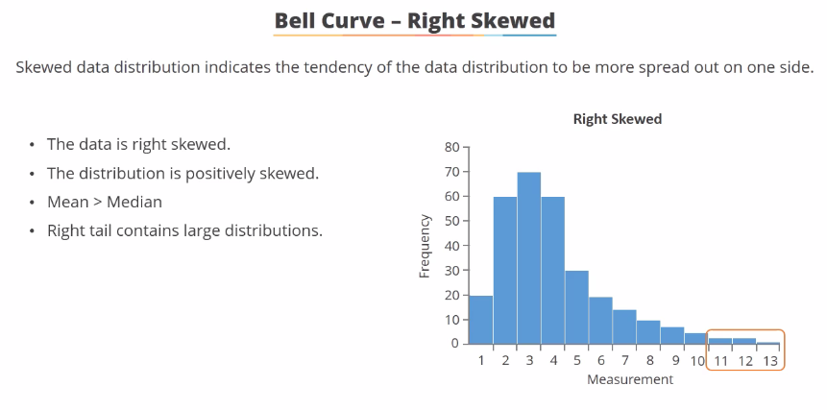

Slide 23
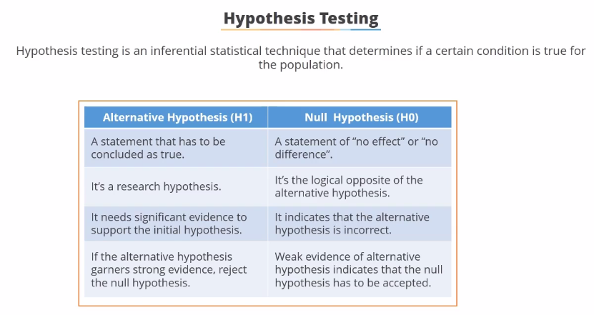

Slide 24
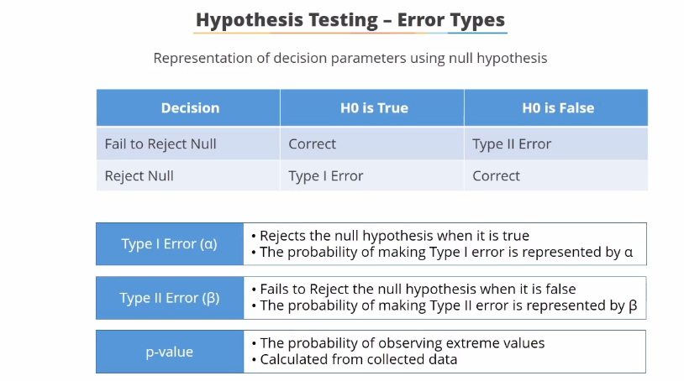

Slide 25
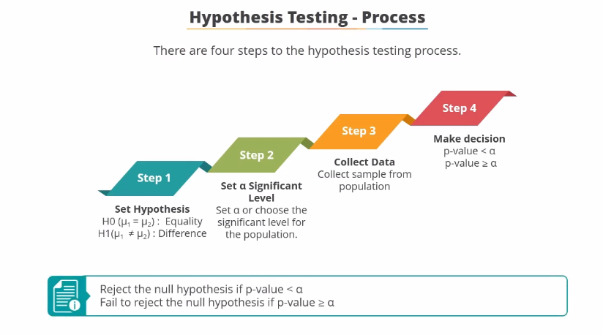

Slide 26
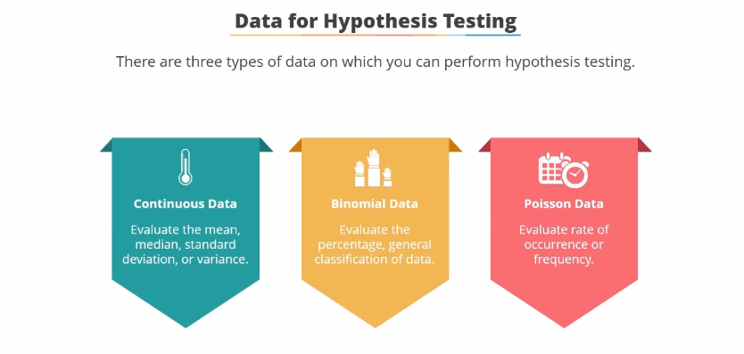

Slide 27
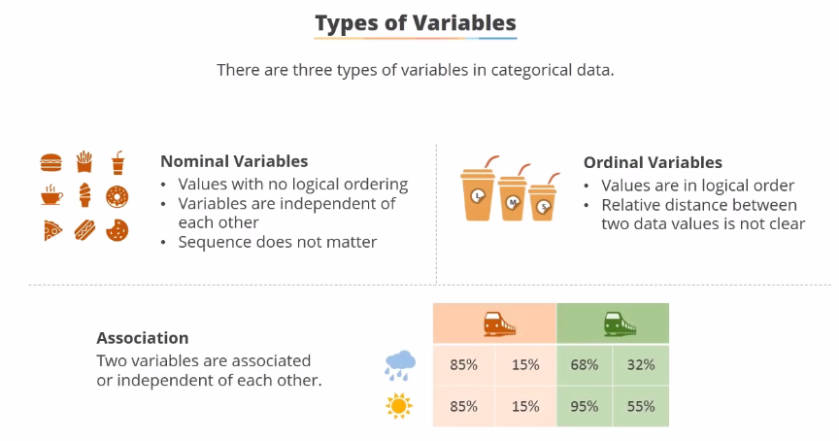

Slide 28
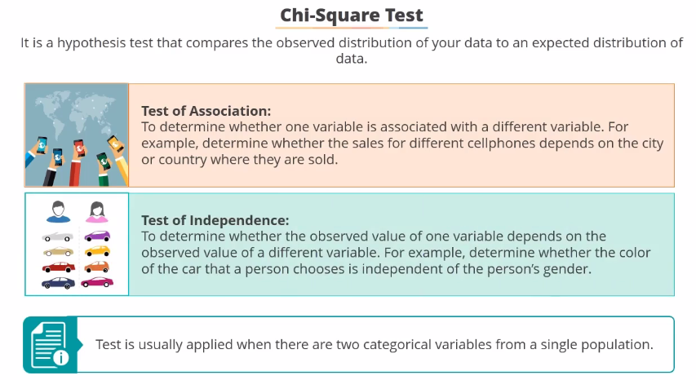

Slide 29
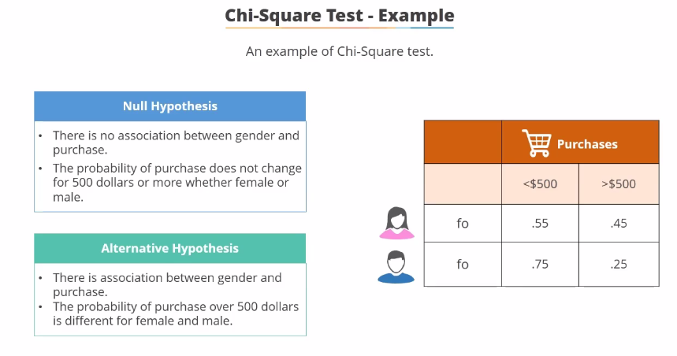

Slide 30
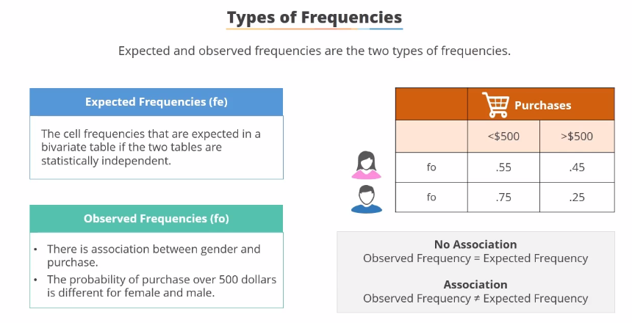

Slide 31
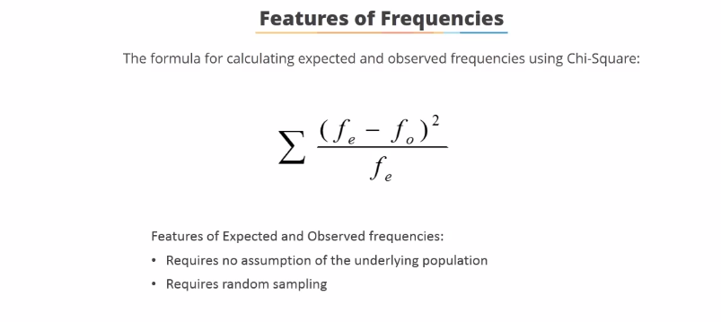

Slide 32
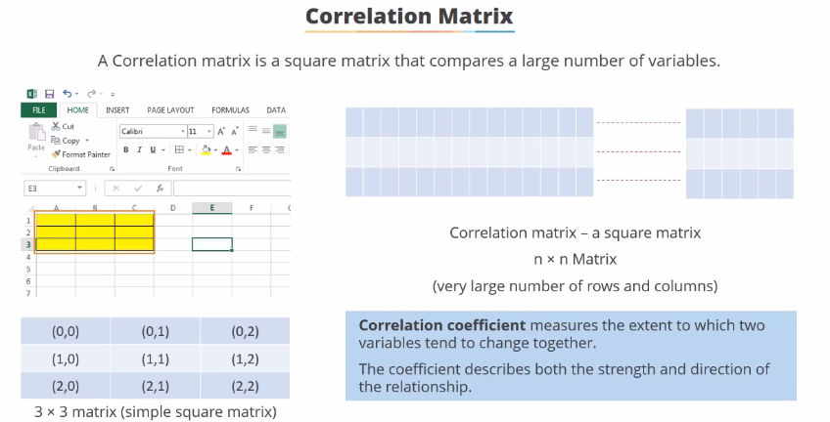

Slide 33
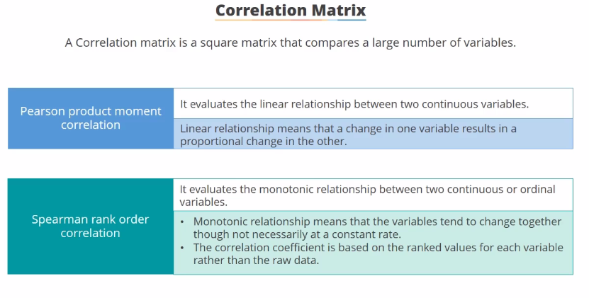

Slide 34
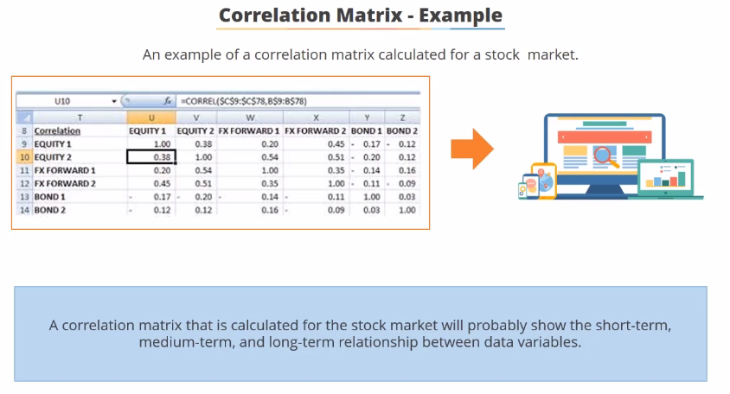

Slide 35
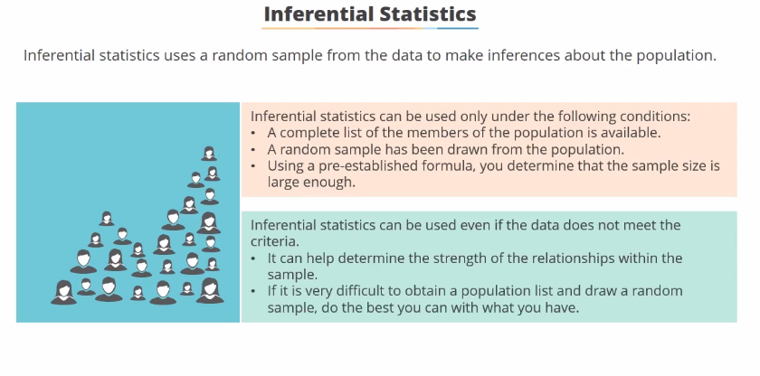

Slide 36
